Slide 1
Week 11
Alexey V. Zimin
JHU BME 580.417/707

Slide 2
Lab #5: Jaccard similarity
In this lab assignment you will write set of functions to compute Jaccard similarity between genomes based on comparison of their fixed size sketches. Due November 13th at 8:00pm
The goal is to write a Python script named jaccard.py containing the following functions:
  reverse_complement(seq): returns reverse complement of sequence seq; reuse this function from Lab #2.
  compute_num_value (seq): returns minimum numerical value between forward and reverse versions of the sequence seq; reuse this function from Lab #2.
  (G:30pt,U:30pt) load_fasta_to_dict(fasta_path): parses fasta file fasta_path and returns a dictionary where keys are names of fasta sequences, and values are the genome sequences
  (G:30pt,U:30pt) compute_sketch(seq_dict,k,s): returns a sketch, which is an array of s smallest distinct integer k-mer values sorted from smallest to largest for all k-mers of size k in all genome sequences in seq_dict
  (G:30pt,U:40pt) compare_sketches(sketch1,sketch2,s): computes Jaccard similarity for sketches sketch1 and sketch2 of size s, returns a floating-point number between 0 and 1.
Graduate students only: (10pt) download two HIV virus sequences from NCBI: accessions GCA_003109165.1 and GCA_003109225.1; use s=20, vary K from 6 to 101, plot Jaccard(K,s). At what value of K Jaccard similarity becomes equal to 0? Upload a figure containing plot of Jaccard(K,s) as function of K. Add a box with value of K’ where Jaccard (K’,20)==0

Slide 3
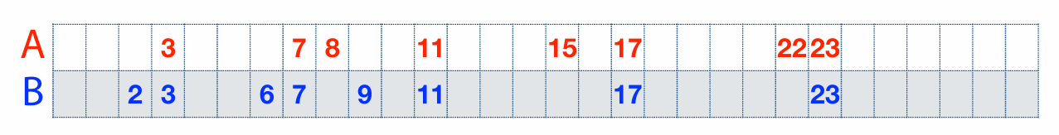
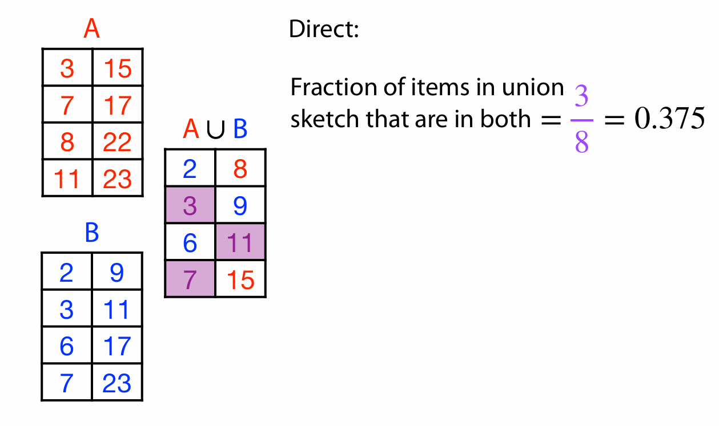
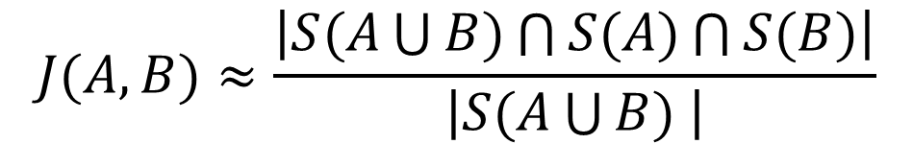
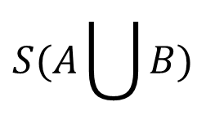


Jaccard similarity example
$$S(A)$$
$$S(A\bigcup{B)}$$
$$S(B)$$
$$J(A,B)≈\frac{\left|S(A\bigcup{B)\bigcap{S(A)}\bigcap{S(B)}}\right|}{\left|S(A\bigcup{B) }\right|}$$

Slide 4
Ab initio gene finding
Transcriptome sequencing data does not provide comprehensive picture of expression – not all transcripts are expressed in all cells at the same time:
  Sequence many different cells under many conditions (expensive)
  Supplement transcriptome sequencing data with an ab initio gene finding algorithm to find transcripts that a not expressed
Assembled transcripts have errors:
  Use machine learning algorithms to detect errors in assembled transcripts
Machine learning:
  Positional Weights/Markov chain/Hidden Markov Models
  Deep Learning Neural Networks

Slide 5
Machine learning algorithms
Protein coding and non-coding sequences have different patterns of letters
Spliceosome does not just cut out introns at GT-AG, it recognizes longer patterns around splice sites
We can look for the patterns with machine learning algorithms
We can model and test the patterns with:
  Positional Probabilities or Positional Weights
  Markov chains
  Deep learning models
ATG…
GT
AG
…TAA
3’ UTR
GT
AG
3’ UTR

Slide 6
Markov chains and HMMs
We can use Positional Probabilities and Markov chains to test whether the sequence patterns around features (such as splice sites GT-AG) correspond to what is expected, which allows us to:
  Look for new features
  Test for correctness of existing features obtained from the data
We will consider application of Positional Probabilities and Markov chains to splice site prediction/validation
We can use Hidden Markov Models (HMMs) to locate regions of sequence that appear to have different properties (coding vs. non-coding)

Slide 7
Positional Probabilities
Positional probabilities is the most straightforward approach to learning and testing sequence patterns
Positional probabilities simply quantify the probabilities of observing A,C,G,T at a certain location in genomic sequence
The probability of a given pattern is the product of individual probabilities derived from the observations at the locations

Slide 8

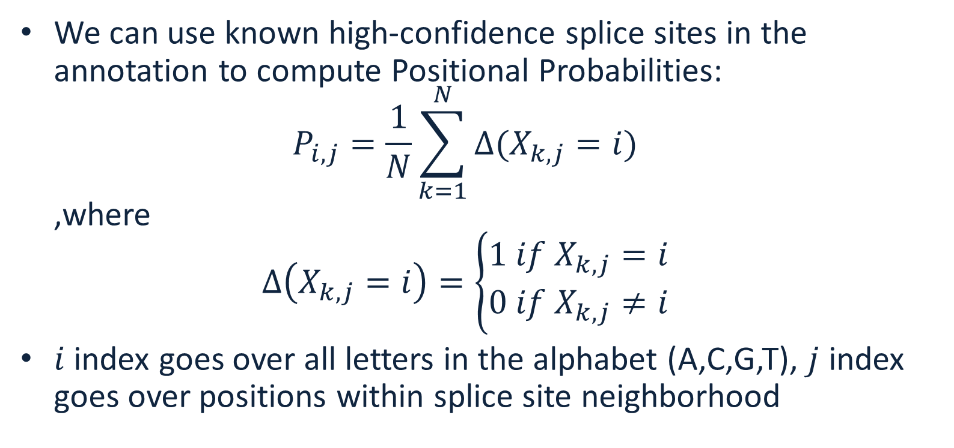
Positional Probabilities
We can use known high-confidence splice sites in the annotation to compute Positional Probabilities:
$P_{i,j}=\frac{1}{N}\sum_{k=1}^{N}{∆(X_{k,j}=i)}$
,where
$∆\left(X_{k,j}=i\right)=\left\{\begin{matrix}1 if{ X}_{k,j}=i \\ 0 if{ X}_{k,j}≠i\end{matrix}\right.$
$i$ index goes over all letters in the alphabet (A,C,G,T), $j$ index goes over positions within splice site neighborhood

Slide 9
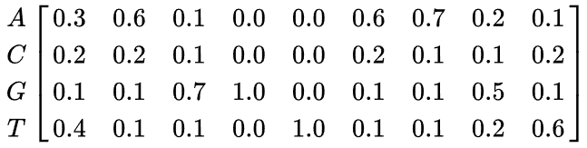
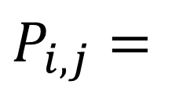
Example
Given DNA sequences:
The Positional Probability Matrix (PPM) is
Computing these probabilities from the data is the learning part
$P_{i,j}=$

Slide 10
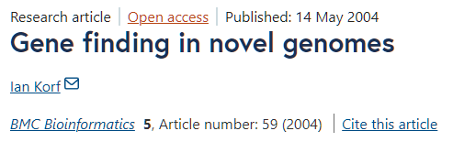
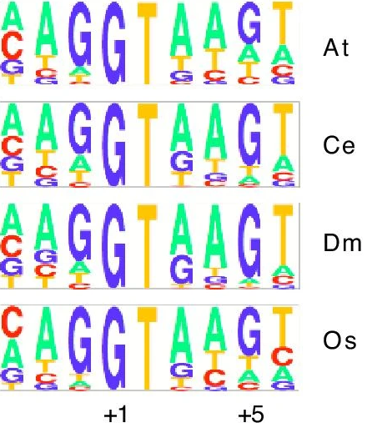
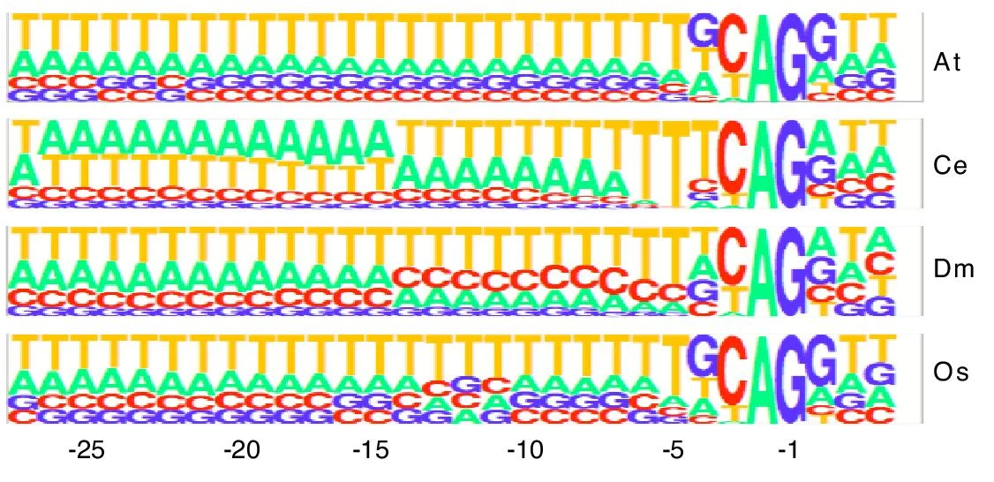
Splice site patterns
Donor (GT)
Acceptor (AG)

Slide 11
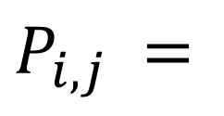
Using PWM to evaluate pattern
We can calculate the probability of a sequence given a PPM, by multiplying the relevant probabilities at each position. For example, the probability of the sequence S = GAGGTAAAC can be calculated:
Compare this to the probability of a random sequence (all probabilities are 0.25) 0.25^9=0.0000038
${P_{i,j}}_{ }=$
$${p(S|P}_{i,j})=.1∗.6∗.7∗1∗1∗.1∗.7∗.2∗.2=0.0007056$$

Slide 12
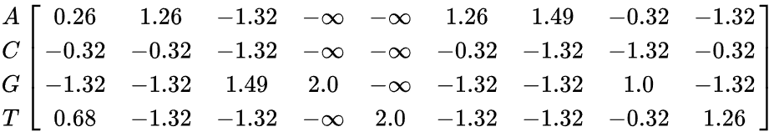
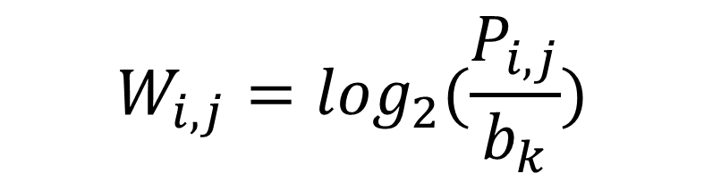
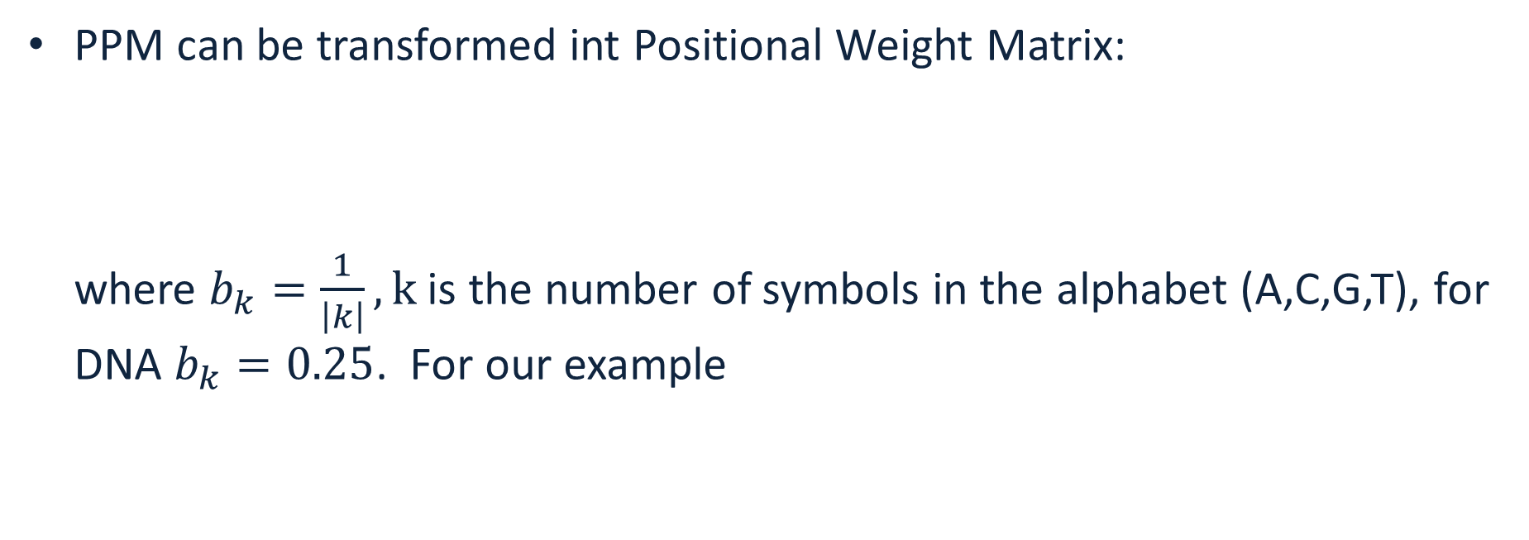

PPM vs PWM
PPM can be transformed int Positional Weight Matrix:
where $b_{k}=\frac{1}{\left|k\right|}, k$ is the number of symbols in the alphabet (A,C,G,T), for DNA $b_{k}=0.25$. For our example
$$W_{i,j}=\log_{2}(\frac{P_{i,j}}{b_{k}})$$
$$W_{i,j}=$$

Slide 13

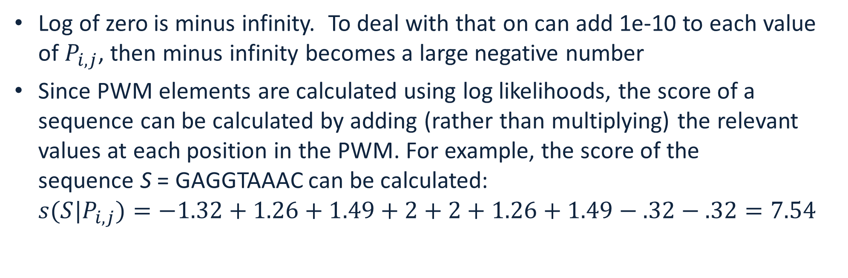
Scoring with PWMs
Log of zero is minus infinity. To deal with that on can add 1e-10 to each value of $P_{i,j}$, then minus infinity becomes a large negative number
Since PWM elements are calculated using log likelihoods, the score of a sequence can be calculated by adding (rather than multiplying) the relevant values at each position in the PWM. For example, the score of the sequence S = GAGGTAAAC can be calculated:
${s(S|P}_{i,j})=−1.32+1.26+1.49+2+2+1.26+1.49−.32−.32=7.54$
$$W_{i,j}=$$

Slide 14
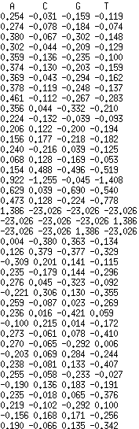
PWM score
The sequence score gives an indication of how different the sequence is from a random sequence (all weights are the same).
The score is 0 if the sequence has the same probability of being a valid pattern (splice site) and of being a random site.
The score is greater than 0 if it is more likely to be a valid site than a random site, and less than 0 if it is more likely to be a random site than a valid site.
This can be generalized to look or test any feature (donor splice site, acceptor splice site, coding start, coding stop)

Slide 15
Drawback of PWMs
PWMs assume statistical independence between positions in the pattern, as the probabilities for each position are calculated independently of other positions.
This assumption does not match reality for splice/start/stop site patterns
Longer correlations are present

Slide 16
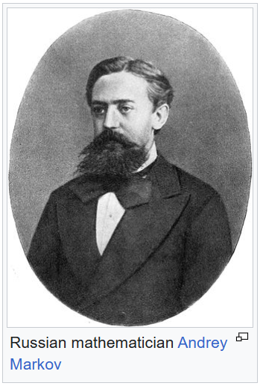
Markov chain
Markov chains allow one to quantify longer distance correlations in patterns
Markov chain or Markov process is a stochastic process describing a sequence of possible events in which the probability of each event depends only on the state attained in the previous event.
Informally, this may be thought of as, "What happens next depends only on the state of affairs now."
Markov processes are named in honor of the Russian mathematician Andrey Markov.

Slide 17
Markov chain
We will consider Discrete-time Markov Chains
A discrete-time Markov chain is a sequence of random variables X₁, X₂, X₃, ... with the Markov property, namely that the probability the next state depends only on the previous states:
Order of the Markov chain is equal to the number of the previous states considered to determine the probability of the next state

Slide 18

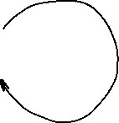

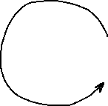
Markov model
Markov model has:
A set of states
Transition probabilities between states
Probabilities of the starting states
Transition probability matrix:
To
B G
From B 0.2 0.8
G 0.5 0.5
Starting probabilities
Pr(B) = 0.6
Pr(G) = 0.4
Markov walk:
BGGBGBGGGBBGBGGGBGGGGB
Outgoing probabilities must sum to 1 !
0.2
0.8
0.5
0.5

Slide 19

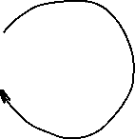

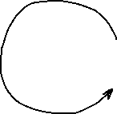
Markov model
For any observed walk we can compute probability that this process generated the walk:
Pr(BGGB)=0.6*0.8*0.5*0.5=0.072
How is this probability useful?
We can use it to distinguish between two Markov Processes!
Transition probability matrix:
To
B G
From B 0.2 0.8
G 0.5 0.5
Starting probabilities
Pr(B) = 0.6
Pr(G) = 0.4
0.2
0.8
0.5
0.5

Slide 20
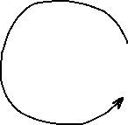

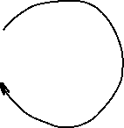
Markov model
Process A Pr(BGGB)=0.6*0.8*0.5*0.5=0.072
Process B Pr(BGGB)=0.5*0.5*0.5*0.5=0.0625
Process A is more likely!
Process A: Starting probabilities Pr(B)=0.6, Pr(G)=0.4
0.2
0.8
Process B: Starting probabilities Pr(B)=0.5, Pr(G)=0.5
0.5
0.5
0.5
0.5
0.5
0.5

Slide 21

Training Markov chain
Training Markov chain involves estimating transition probability matrix from the data under a given model
1st order Markov chain for DNA: the probability of the next letter depends only on the previous letter in the pattern
One can estimate transition probabilities by counting all tuples T_{i}=(“AA”,”AC”,”AG”,”AT”,”CA”,....,”TT”) in the DNA data, and dividing the count of each tuple starting with A, C, G, T by the total number of T_{i} starting with A, C, G and T
To
A C G T
A .1 .4 .4 .1
From C .2 .2 .3 .3
G .4 .4 .1 .1
T .5 .1 .2 .2
rows must add up to 1
A
C
G
T

Slide 22

Scoring with Markov chain
Imagine sequence AGCG, all starting probabilities are equal to 0.25. Its probability under this Markov model is P = 0.25*0.4*0.4*0.3=0.012
Probability that this sequence has ben generated from a random walk is 0.25⁴ = 0.00390625
You can compare probabilities between different Markov chain models to see which model is more likely to have generated the pattern
To
A C G T
A .1 .4 .4 .1
Model 1 From C .2 .2 .3 .3
G .4 .4 .1 .1
T .5 .1 .2 .2
To
A C G T
A .25 .25 .25 .25
Model 2 From C .25 .25 .25 .25
(random walk) G .25 .25 .25 .25
T .25 .25 .25 .25
A
C
G
T

Slide 23
Markov Weight Array Matrix
A Weight Array Matrix (WAM) is a specific kind of Markov chain model that incorporates positions within the pattern
WAM works better than PWM in scoring patterns because it incorporates Markov chain transition probabilities: the probability of each letter depends both on the position and on the previous one (or more) letters
The Markov process weights change from one position to another within the pattern
For the first order Markov process we need 16 weights at each position

Slide 24

PWM vs WAM
PWM -- probabilities of observing each letter at a given position only depend on the position in the pattern:
123456789
GAATGAGA
here the probability of seeing A at the position 2 is a number that only depends on the position (2)
1st order Markov WAM -- probabilities of observing each letter at a given position depend on the position in the pattern and on the previous letter:
123456789
GAATGAGA
here the probability of seeing A at the position 2 is a number that depends on the position (2) and on the previous letter (G)

Slide 25
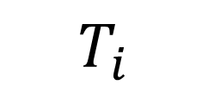
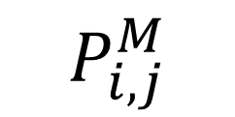
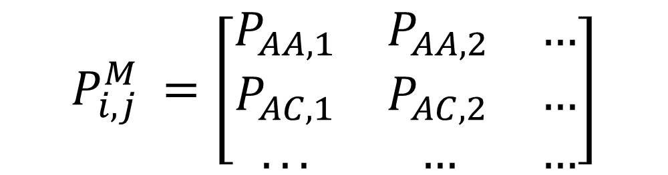
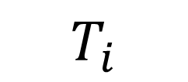
Markov Weight Array Matrix
1st order Markov WAM based on on the 1st order Markov chain
Computation of probabilities is the same as for the Positional Probabilities, except the alphabet is tuples (AA,AC,AG,AT,CA,....,TT), size=16
Let each tuple be . Estimate from the data probabilities for every ; for a pattern of length n, the matrix will have dimensions 16 by (n-1)
$$T_{i}$$
$$T_{i}$$
$$P_{i,j}^{M}$$
$${P_{i,j}^{M}}_{ }=\left[\begin{matrix}P_{AA,1} & P_{AA,2} & … \\ P_{AC,1} & P_{AC,2} & … \\ ... & … & …\end{matrix}\right]$$

Slide 26
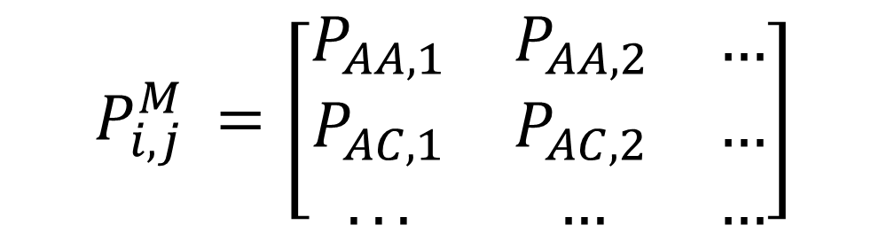

Markov Weight Array Matrix
$P_{i,j}^{M}=\frac{1}{N}\sum_{k=1}^{N}{∆(X_{k,j}=i)}, X^{′}s and i^{′}s$ are now AA,AC,AG,… etc
$$∆\left(X_{k,j}=i\right)=\left\{\begin{matrix}1 if{ X}_{k,j}=i \\ 0 if{ X}_{k,j}≠i\end{matrix}\right.$$
The idea is the same as for positional probabilities, but now you are working with tuples of letters: e.g. instead of counting how many times you’ve seen A, C, G or T in the first position, you count how many times you’ve seen AA, AC,…. in the first position, etc
$${P_{i,j}^{M}}_{ }=\left[\begin{matrix}P_{AA,1} & P_{AA,2} & … \\ P_{AC,1} & P_{AC,2} & … \\ ... & … & …\end{matrix}\right]$$

Slide 27
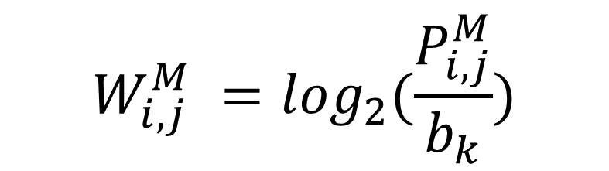
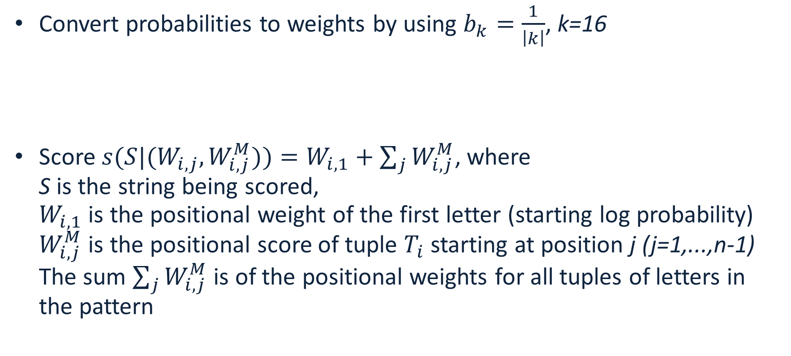
Scoring pattern with Markov WAM
Convert probabilities to weights by using $b_{k}=\frac{1}{\left|k\right|}$, k=16
Score ${s(S|(W}_{i,j},W_{i,j}^{M}))=W_{i,1}+\sum_{j}{W_{i,j}^{M}}$, where
S is the string being scored,
$W_{i,1}$ is the positional weight of the first letter (starting log probability)
$W_{i,j}^{M}$ is the positional score of tuple $T_{i}$ starting at position j (j=1,...,n-1) The sum $\sum_{j}{W_{i,j}^{M}}$ is of the positional weights for all tuples of letters in the pattern
$$W_{i,j}^{M} =\log_{2}(\frac{P_{i,j}^{M}}{b_{k}})$$

Slide 28
Estimation of negative hypothesis
Weight Array or Markov chain score is related to the probability that the Markov process(es) generated the pattern
One can compare it to the “negative” hypothesis -- score under a model trained on randomly chosen “invalid” patterns: genome sequences of length n that are not valid patterns
A reasonable assumption is that for the negative hypothesis all probabilities are the same, so the sum of the weights is 0 (zero), thus a score above zero indicates a match to the pattern
  Genomes with strong GC-bias (more G’s and C’s compared to A’s and T’s) fail that assumption

Slide 29
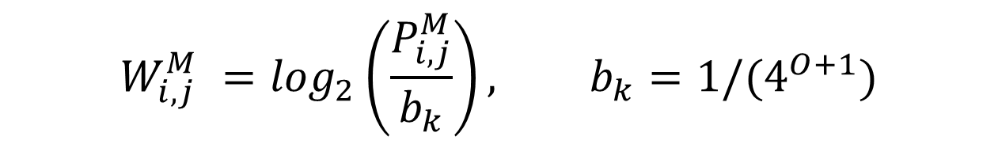
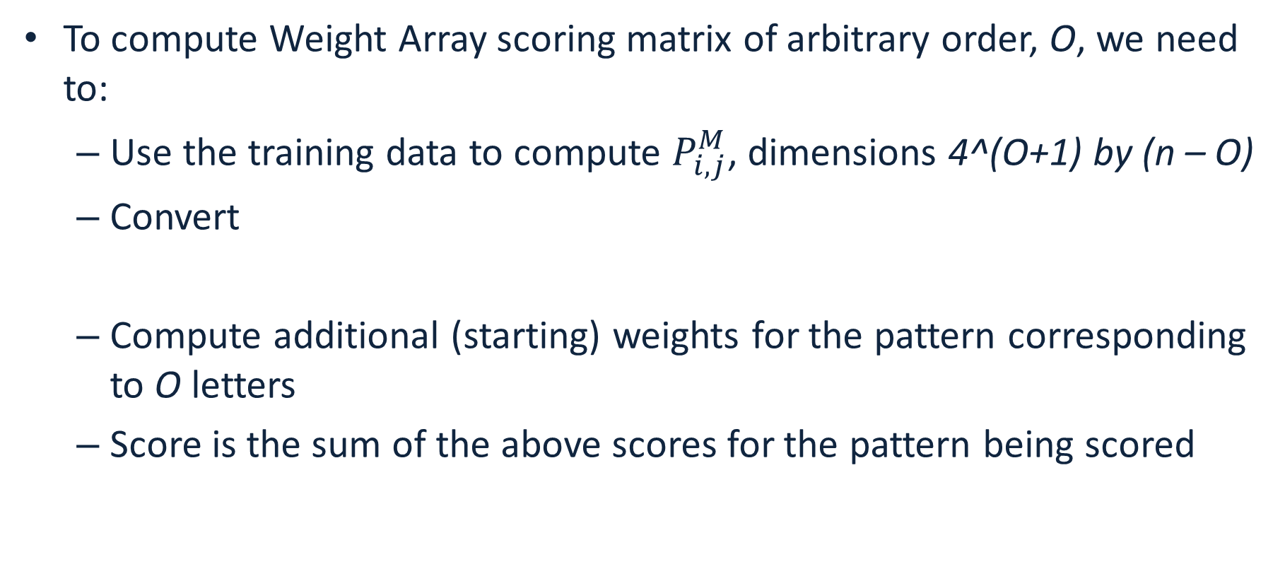
Extend to arbitrary order
To compute Weight Array scoring matrix of arbitrary order, O, we need to:
  Use the training data to compute $P_{i,j}^{M}$, dimensions 4^(O+1) by (n – O)
  Convert
  Compute additional (starting) weights for the pattern corresponding to O letters
  Score is the sum of the above scores for the pattern being scored
$$W_{i,j}^{M} =\log_{2}\left(\frac{P_{i,j}^{M}}{b_{k}}\right), b_{k}={1/(4}^{O+1})$$

Slide 30
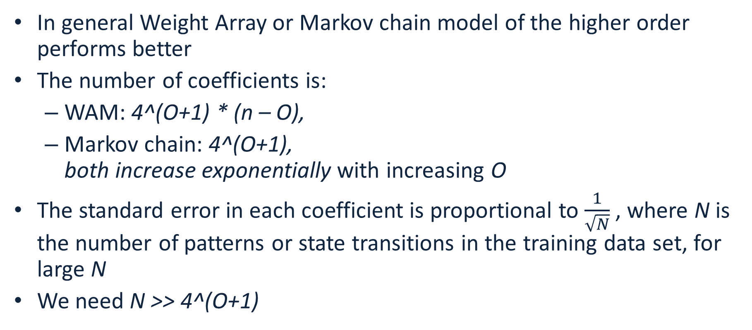
How to choose the order of Markov chain or WAM
In general Weight Array or Markov chain model of the higher order performs better
The number of coefficients is:
  WAM: 4^(O+1) * (n – O),
  Markov chain: 4^(O+1),
  both increase exponentially with increasing O
The standard error in each coefficient is proportional to $\frac{1}{\sqrt{N}}$, where N is the number of patterns or state transitions in the training data set, for large N
We need N >> 4^(O+1)

Slide 31
Hidden Markov Models
Imagine that we cannot observe/measure the states directly, but the states emit data
The goal is to determine the most likely sequence of states given the model and the observed data
0.8
0.2
0.8
0.2

Slide 32
Hidden Markov Models
A Hidden Markov Model is a Markov model that emits data at each state with different probability distributions, and transition probabilities are known (or can be estimated)
Blue state emits data distributed according to probabilities P_{b} and Green state emits data distributed with probabilities P_{g}
0.8
0.2
0.8
0.2

Slide 33
The game
Imagine the following game:
  One coin is fair: probability of heads or tails is 50%
  One coin is biased: probability of heads is 90%
  Coins look identical to us (state cannot be observed directly)
The game (repeats N times):
  Dealer picks a coin with probability 50% in secret, flips it and makes the result visible
  Dealer then switches the coin with probability 20% in secret
Our goal is to guess which coin is used at every toss
0.8
0.2
0.8
Fair (F)
Bias (B)
0.2

Slide 34
Hidden Markov Models
A walk in HMM from the dealer’s perspective:
FFBB
HTHH
We observe:
HTHH
0.8
0.2
0.8
Fair (F)
Bias (B)
0.2

Slide 35
Hidden Markov Models
A walk in HMM from the dealer’s perspective:
FFBB
HTHH
It is easy for the dealer to compute the probability:
Pr(FFBB)=Pr(start in F)*Pr(emit H in F)*Pr(stay in F)* Pr(emit T in F)* Pr(switch to B)* Pr(emit H in B)*Pr(stay in B)* Pr(emit H in B) =
0.5*0.5*0.8*0.5*0.2*0.9*0.8*0.9
0.8
0.2
0.8
Fair (F)
Bias (B)
0.2

Slide 36
Hidden Markov Models
A walk in HMM from the dealer’s perspective:
FFBB
HTHH
What can we do? The coins are hidden from us!
Try all possible sequences of 4-letter combinations of F and B, compute probabilities (2^4)
0.8
0.2
0.8
Fair (F)
Bias (B)
0.2

Slide 37
Hidden Markov Models
F
B
F
B
F
B
2^4=16 probabilities,
Pick the guess with the highest probability
Not feasible to do for long runs!!!
F
B
F
B
F
B
F
B
F
B
F
B
F
B
F
B
F
B
F
B
F
B
F
B
0.8
0.2
0.8
Fair (F)
Bias (B)
0.2

Slide 38
Hidden Markov Models
Use Viterbi algorithm for long runs
  Input: HMM and the sequence: HHTH…
  Output: a state sequence with maximum probability: FFBB…
0.8
0.2
0.8
Fair (F)
Bias (B)
0.2

Slide 39
Gene finding with HMMs
We know the sequence of a genome, how can we find where the coding sequences are?
AGAATGGATAGATAGGATAATAATGGGAAATTGATTTAAATTTA --?
The coding/noncoding regions are hidden states (like the coins)
Patterns of letters within coding and noncoding sequences differ
We can use the RNA-seq data or a closely related genome to:
  compute patterns for coding/noncoding sequence -- these are our emission probabilities
  compute transition probabilities between coding/noncoding states

Slide 40
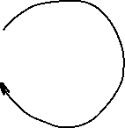

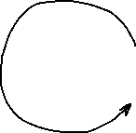
Gene finding with HMMs
Closely related annotated genome:
AGAATGGGTAGATAGGATCATAATGGCAAATTGATTTATATTTA
Assume a model:
44 letters, 2 coding->non-coding and 2 non-coding-> coding transitions
Train the model by computing emission probabilities:
  Coding: A:9/24, C:1/24, G:8/24, T:6/24
  Noncoding: A:8/20, C:1/20, G:2/20, T:9/20
Use Viterbi algorithm to figure out most likely sequence of states (N or C) given the model and emission probabilities; label the letters
21/22
1/22
21/22
Non-
coding
(N)
Coding
(C)
1/22

